Slide 1

Swisscom Network Observability Transforms and Innovates Network Operations
15.03.2026
Wanting Du - wanting.du@swisscom.com
Thomas Graf – thomas.graf@swisscom.com
Picture: Apollo 8, December 24th 1968
Notes:
Missing agentic ai in the title

Slide 2

Agentic AI and its Network Analytics Applicability Exampled on Network Anomaly Detection
Autonomous, Agentic AI, Generative AI and Large Language Models are recent buzzwords which excite beyond the network industry.
In order to explain how this affects Network Analytics, with Network Anomaly Detection as a concrete example, we need to understand the foundation, how Data Models, Rich Semantics, Ontology, Taxonomy and Knowledge Graphs work. Data models represent a basic form of organizing structured data. Semantics give data meaning. Taxonomy its relation.
"AI Fascinates Throughout History"

Slide 3
“ With postmortems we learn. We can't have enough of them. Agentic AI can help us to automate postmortems by analyzing and gathering data and refining the incident detection. “

Slide 4
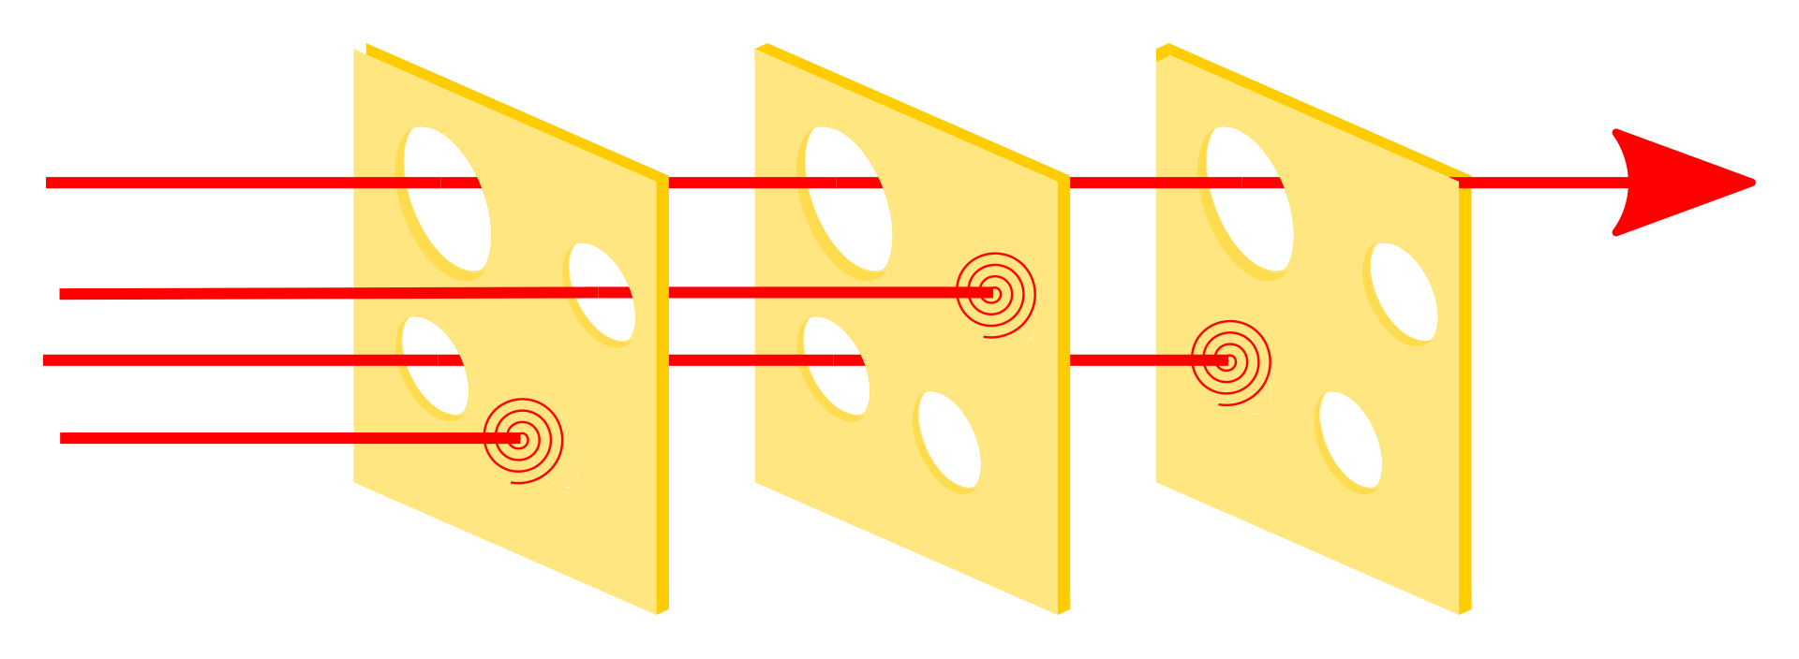
Swiss cheese model of accident causation Mostly multiple interacting causes lead to an incident
“ The Swiss cheese model of accident causation is a model used in risk analysis and risk management. It likens human systems to multiple slices of Swiss cheese, which have randomly placed and sized holes in each slice, stacked side by side, in which the risk of a threat becoming a reality is mitigated by the different types of defenses which are "layered" behind each other. Therefore, in theory, lapses and weaknesses in one defense (e.g. a hole in one slice of cheese) do not allow a risk to materialize, since other defenses also exist (e.g. other slices of cheese), to prevent a single point of failure. “
https://en.wikipedia.org/wiki/Swiss_cheese_model
Notes:
What's the relationship with ai and the following incident example

Slide 5

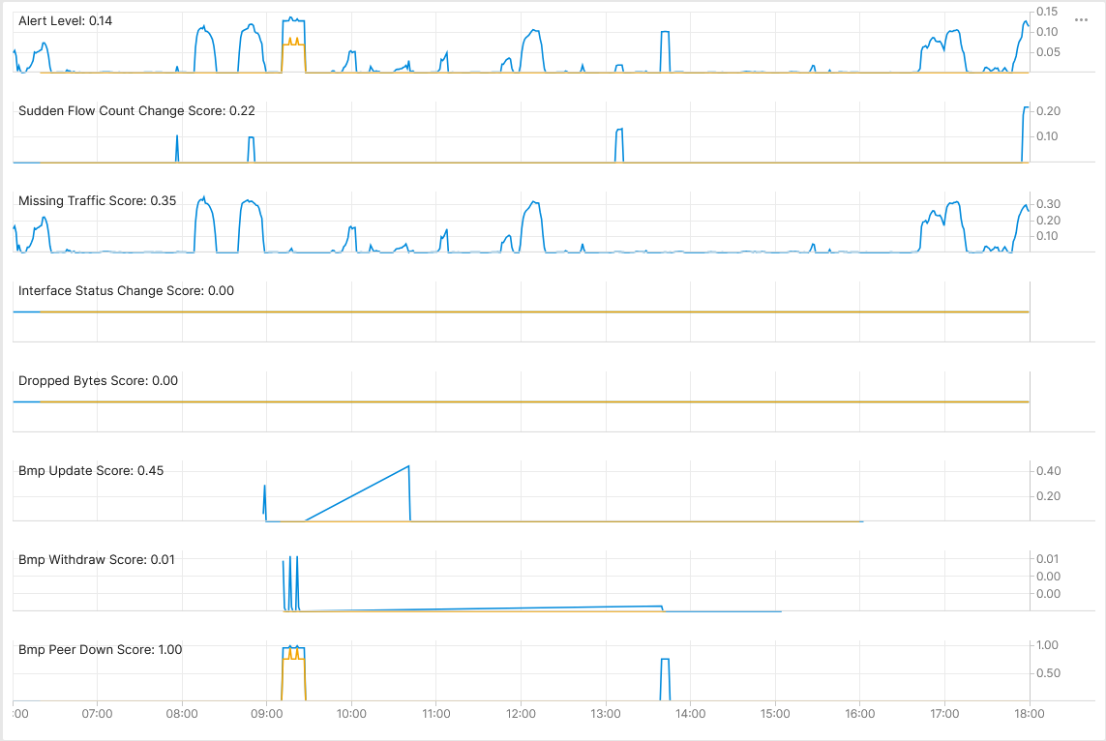



September 4th, Maximum Prefix BGP Peer State Change External Cloud Access, AWS Peering
Long time ago, when a new L3 VPN connectivity service was created, the maximum prefix limit on a BGP peering at AWS public cloud was defined but not proactively monitored.
On September 4th at 08:55 additional prefixes were advertised into the L3 VPN and observed by Cosmos Bright Lights Network Anomaly Detection but nor alerted.
At 09:08 additional prefixes were advertised and soon after the BGP peering was teared. Before peering teardown, the AWS BGP speaker notified Swisscom's PE node the reason of the peer down. The Swisscom PE node forwarded in the BMP peer_down notification to the data collection where the peer_down but not the reason was decoded. Cosmos Bright Lights Network Anomaly Detection observed the topology and peering state changes but did not alert.
Some time later network operation was contacted due to customer facing incident…
Cosmos Bright Lights monitoring 64498:46982 64498:55780 L3 VPN in real-time during incident window – Pivot Link

Slide 6
YANG Data Taxonomy oper-status and last-changed in ietf-interfaces
module: ietf-interfaces
+--rw interfaces
+--rw interface* [name]
+--rw name string
+--rw description? string
+--rw type identityref
+--rw enabled? boolean
+--rw link-up-down-trap-enable? enumeration {if-mib}?
+--ro admin-status enumeration {if-mib}?
+--ro oper-status enumeration
+--ro last-change? yang:date-and-time
+--ro if-index int32 {if-mib}?
+--ro phys-address? yang:phys-address
+--ro higher-layer-if* interface-ref
+--ro lower-layer-if* interface-ref
+--ro speed? yang:gauge64
+--ro statistics
+--ro discontinuity-time yang:date-and-time
+--ro in-octets? yang:counter64
+--ro in-unicast-pkts? yang:counter64
+--ro in-broadcast-pkts? yang:counter64
+--ro in-multicast-pkts? yang:counter64
+--ro in-discards? yang:counter32
+--ro in-errors? yang:counter32
+--ro in-unknown-protos? yang:counter32
+--ro out-octets? yang:counter64
+--ro out-unicast-pkts? yang:counter64
+--ro out-broadcast-pkts? yang:counter64
+--ro out-multicast-pkts? yang:counter64
+--ro out-discards? yang:counter32
+--ro out-errors? yang:counter32
For instance take ietf-interfaces.yang as an example for an interface data model and the leaf "oper-status" defines the operational state of that interface and the leaf "last-change" when the last state change occurred. YANG schema trees facilitate a visual representation, the taxonomy of YANG data models.
Notes:
Sentences to key points

Slide 7
leaf oper-status {
type enumeration {
enum up {
value 1;
description
"Ready to pass packets.";
}
enum down {
value 2;
description
"The interface does not pass any packets.";
}
enum testing {
value 3;
description
"In some test mode. No operational packets can
be passed.";
}
enum unknown {
value 4;
description
"Status cannot be determined for some reason.";
}
enum dormant {
value 5;
description
"Waiting for some external event.";
}
enum not-present {
value 6;
description
"Some component (typically hardware) is missing.";
}
enum lower-layer-down {
value 7;
description
"Down due to state of lower-layer interface(s).";
}
}
config false;
mandatory true;
description
"The current operational state of the interface.
This leaf has the same semantics as ifOperStatus.";
reference
"RFC 2863: The Interfaces Group MIB - ifOperStatus";
}
YANG Semantics oper-status in ietf-interfaces
Looking at "oper-status" in the data model definition we see "description" and "reference" as properties, together with identities, they describe the meaning of the data or in other words the semantics in YANG.

Slide 8
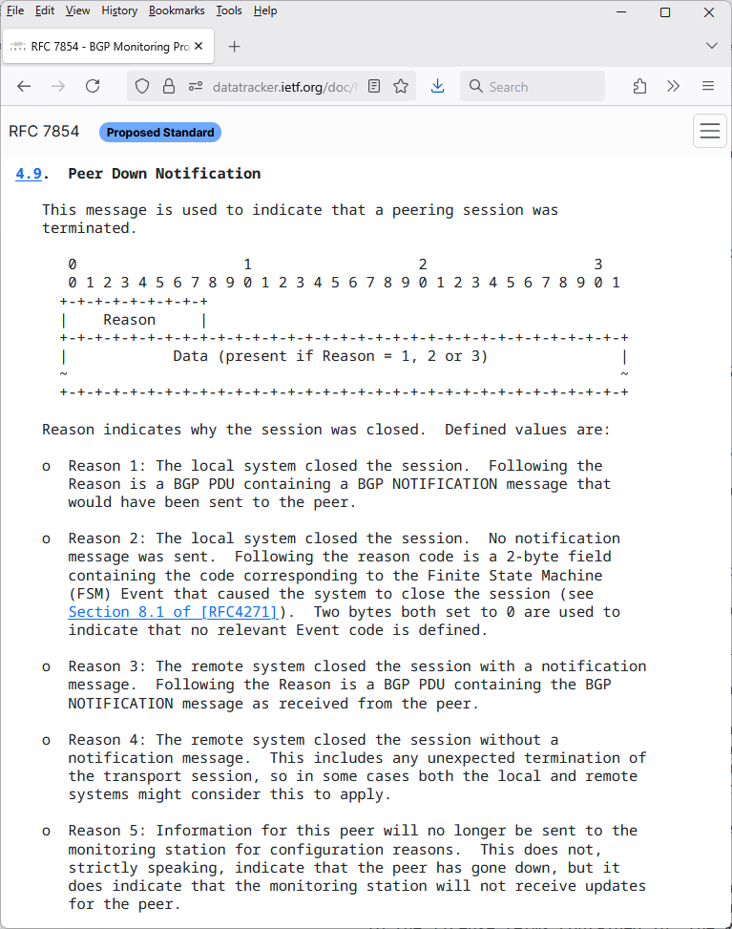
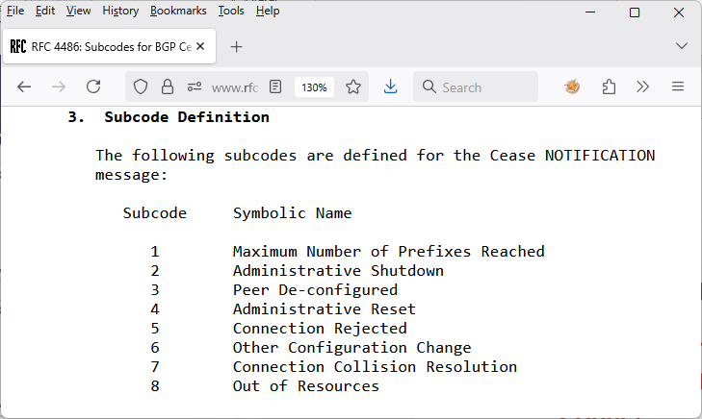
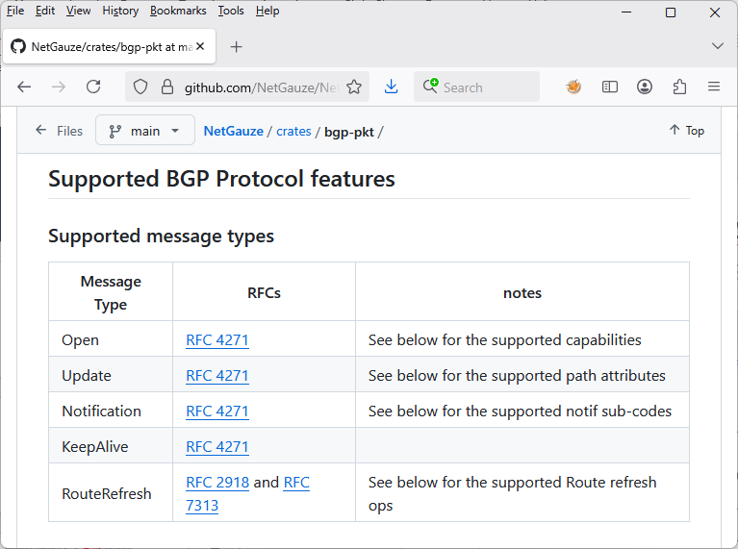
September 4th, Maximum Prefix BGP Peer State Change BGP notifications and BMP Peer Down Message
BGP notifications propagate reason for BGP peer tear down. BMP mirrors BGP notification at BGP Adj-RIB In with reason code 3. If no notification was received but TCP reset was received, then reason code 4 is used.
Show BGP neighbor output in CLI
RP/0/RP0/CPU0:pca01ro1072olt#sho bgp vrf EXTCC-00508-00 neighbor 100.100.98.209
.......
Time since last notification received from neighbor: 00:34:13
Error Code: maximum number of prefixes reached
Notification data received:

Slide 9
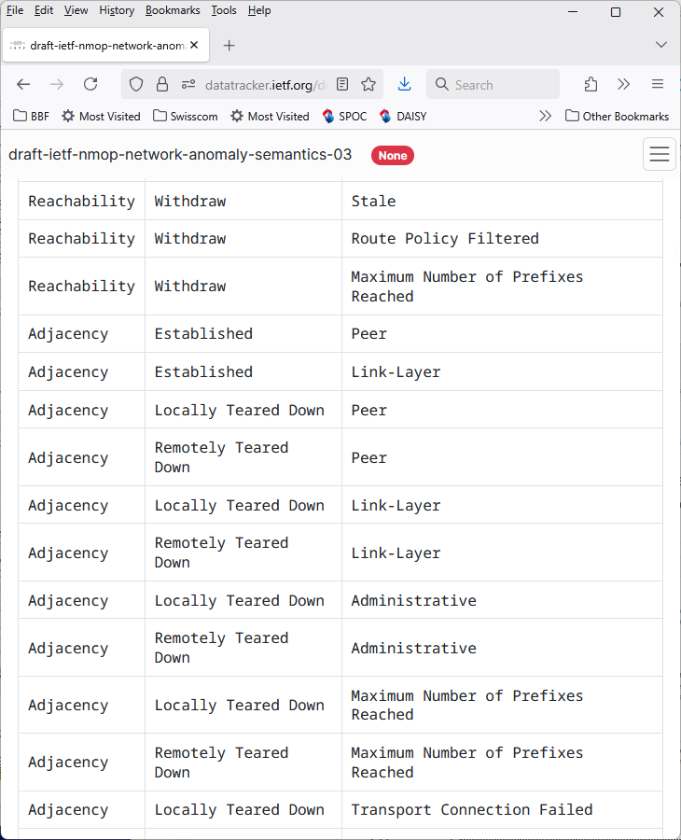
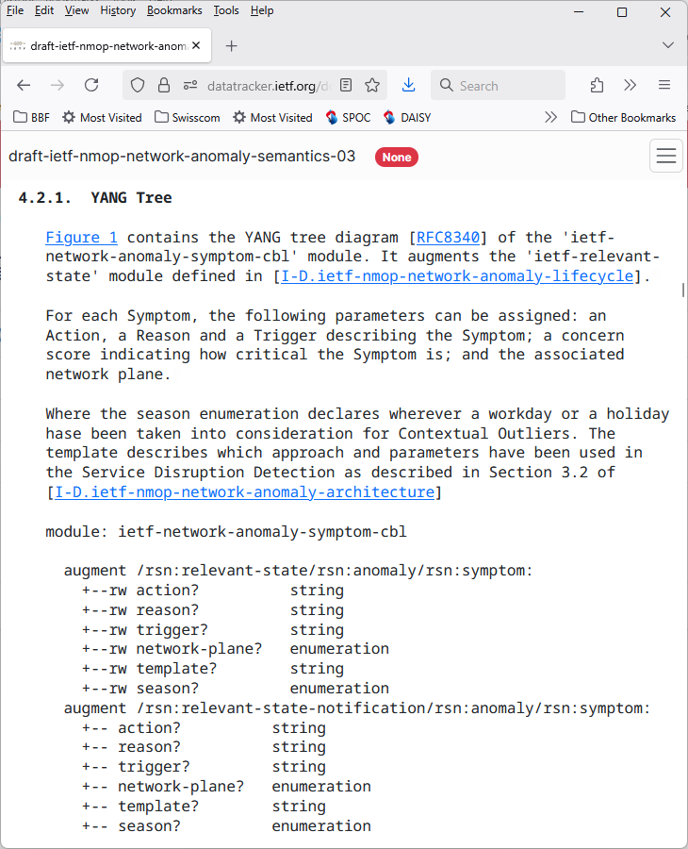
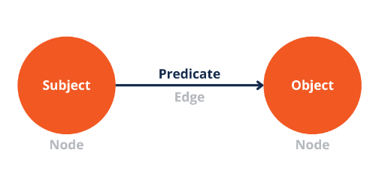
September 4th, Maximum Prefix BGP Peer State Change draft-ietf-nmop-network-anomaly-semantics - Symptoms: Action – Reason – Trigger
In Postmortems, the causality is a key concern. With symptoms we describe the causality tree in a human and machine-readable ontology.
The symptoms is defined in semantic triple. Where "action" is the object, "trigger" the predicate and the reason "subject".
With semantic triple we knowledge graph.
https://datatracker.ietf.org/doc/html/draft-ietf-nmop-network-anomaly-semantics-03#symptom_control_plane_actions_table
https://datatracker.ietf.org/doc/html/draft-ietf-nmop-network-anomaly-semantics-03#section-4.2.1

Slide 10

Problem Statement and Motivation How it is being addressed in which document
Network Anomaly Detection
When operational or configurational changes in connectivity services are happening, the objective is to detect interruption at network operation faster than the users using those connectivity services.
In order to achieve this objective, automation in network monitoring is required. This automation needs to monitor network changes holistically by monitoring all 3 network planes simultaneously and detect whether that change is service disruptive.
Through network incidents postmortems we network operators learn and improve so does network anomaly detection and supervised and semi-supervised machine learning. With more and more incidents the postmortem process demands automation and with the standardization of labeled network incident collaboration among network operators, vendors and academia is facilitated.
draft-ietf-nmop-network-anomaly-architecture describes the motivation and architecture and the relationship to other two documents.
draft-ietf-nmop-network-anomaly-semantics defines Symptom semantics to enable standardized data exchange to validate results with network engineers and improve supervised and semi-supervised machine learning systems.
draft-ietf-nmop-network-anomaly-lifecycle describes on managing the lifecycle process, in order to facilitate network engineers to interact with the network anomaly detection system to refine the detection abilities over time.

Slide 11
IETF NMOP - Semantic Metadata Annotation for Network Anomaly Detection draft-ietf-nmop-network-anomaly-semantics – Schema Tree
notifications:
+---n relevant-state-notification
+--ro publisher
| +--ro id? yang:uuid
| +--ro name string
| +--ro version? string
+--ro id yang:uuid
+--ro uri? inet:uri
+--ro description? string
+--ro start-time yang:date-and-time
+--ro end-time? yang:date-and-time
+--ro smcblsymptom:strategy? string
+--ro confidence-score? score
+--ro concern-score score
+--ro (service)?
| +--:(smtopology:l2vpn)
| | +--ro smtopology:vpn-service* [vpn-id]
| | +--ro smtopology:vpn-id string
| | +--ro smtopology:uri? inet:uri
| | +--ro smtopology:vpn-name? string
| | +--ro smtopology:site-ids* string
| | +--ro smtopology:change-id? yang:uuid
| | +--ro smtopology:change-start-time?
| | | yang:date-and-time
| | +--ro smtopology:change-end-time?
| | yang:date-and-time
| +--:(smtopology:l3vpn)
| +--ro smtopology:vpn-service* [vpn-id]
| +--ro smtopology:vpn-id string
| +--ro smtopology:uri? inet:uri
| +--ro smtopology:vpn-name? string
| +--ro smtopology:site-ids* string
| +--ro smtopology:change-id? yang:uuid
| +--ro smtopology:change-start-time?
| | yang:date-and-time
| +--ro smtopology:change-end-time?
| yang:date-and-time
notifications:
+---n relevant-state-notification
+--ro anomaly* [id revision]
+--ro id yang:uuid
+--ro revision yang:counter32
+--ro uri? inet:uri
+--ro state identityref
+--ro description? string
+--ro start-time
| yang:date-and-time
+--ro end-time?
| yang:date-and-time
+--ro confidence-score? score
+--ro pattern? identityref
+--ro annotator
| +--ro id? yang:uuid
| +--ro name string
| +--ro version? string
| +--ro annotator-type? enumeration
+--ro symptom!
| +--ro id yang:uuid
| +--ro concern-score score
| +--ro smcblsymptom:action? string
| +--ro smcblsymptom:reason? string
| +--ro smcblsymptom:trigger? string
| +--ro smcblsymptom:network-plane? enumeration
| +--ro smcblsymptom:template? string
| +--ro smcblsymptom:season? Enumeration
+--ro smtopology:vpn-node-terminations*
[hostname route-distinguisher]
+--ro smtopology:hostname inet:host
+--ro smtopology:route-distinguisher string
+--ro smtopology:peer-ip* inet:ip-address
+--ro smtopology:next-hop* inet:ip-address
+--ro smtopology:interface-id* uint32
Shows the observed symptoms, the network dimensions triggering and connectivity service impacted.

Slide 12
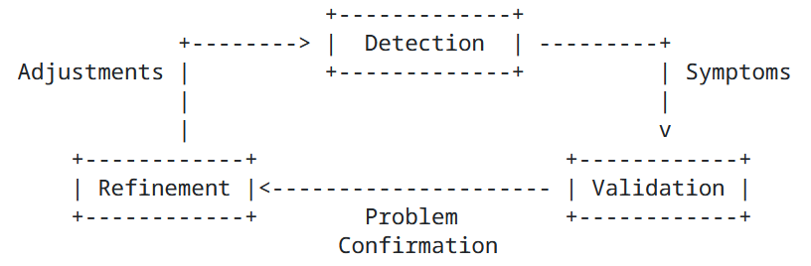
Anomaly Detection Refinement Lifecycle (1) Gaining validated knowledge
With postmortems we network operators gain insights into the reasoning of network incidents by looking at what happened, which operational metrics were available and which analytical conclusion we derived. Obviously in this postmortem process we gather and link this knowledge. Obviously, this linked knowledge can be graphed. Obviously out of this linked and graphed knowledge new knowledge can be derived with Large Language Models and with Agentic AI reasoning can be deducted and autonomous action can be applied, like new and improved disruption checks are being proposed and tested as part of the network anomaly detection lifecycle workflow.
Notes:
Remove (1)

Slide 13
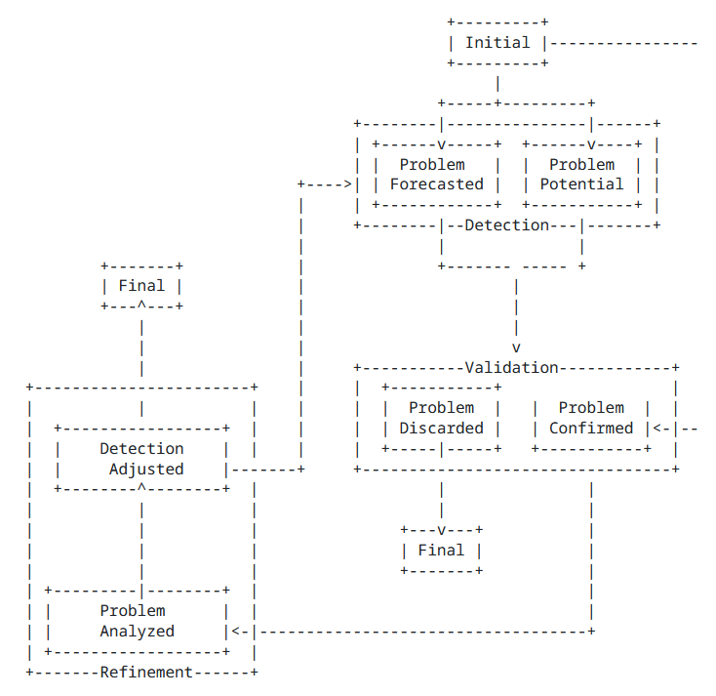
Anomaly Detection Refinement Lifecycle (2) Gaining validated knowledge
Data replay is an important tool in Network Anomaly Detection. It helps to refine the outlier detection. To find the right hyper parameters for the right algorithm. With data replay we test and verify. With Agentic AI we can expand to what-if. Besides trying out different hyper parameters and algorithms we can now leverage based on Knowledge Graph relationships and Agentic AI inference new knowledge, new untapped aspects of modeled network data.
Our Conclusion:
Agentic AI can help to automate the refinement process of Network Anomaly Detection. Would you agree?
Notes:
Maybe better to move to the beginning to keep people focus

